Slide 1
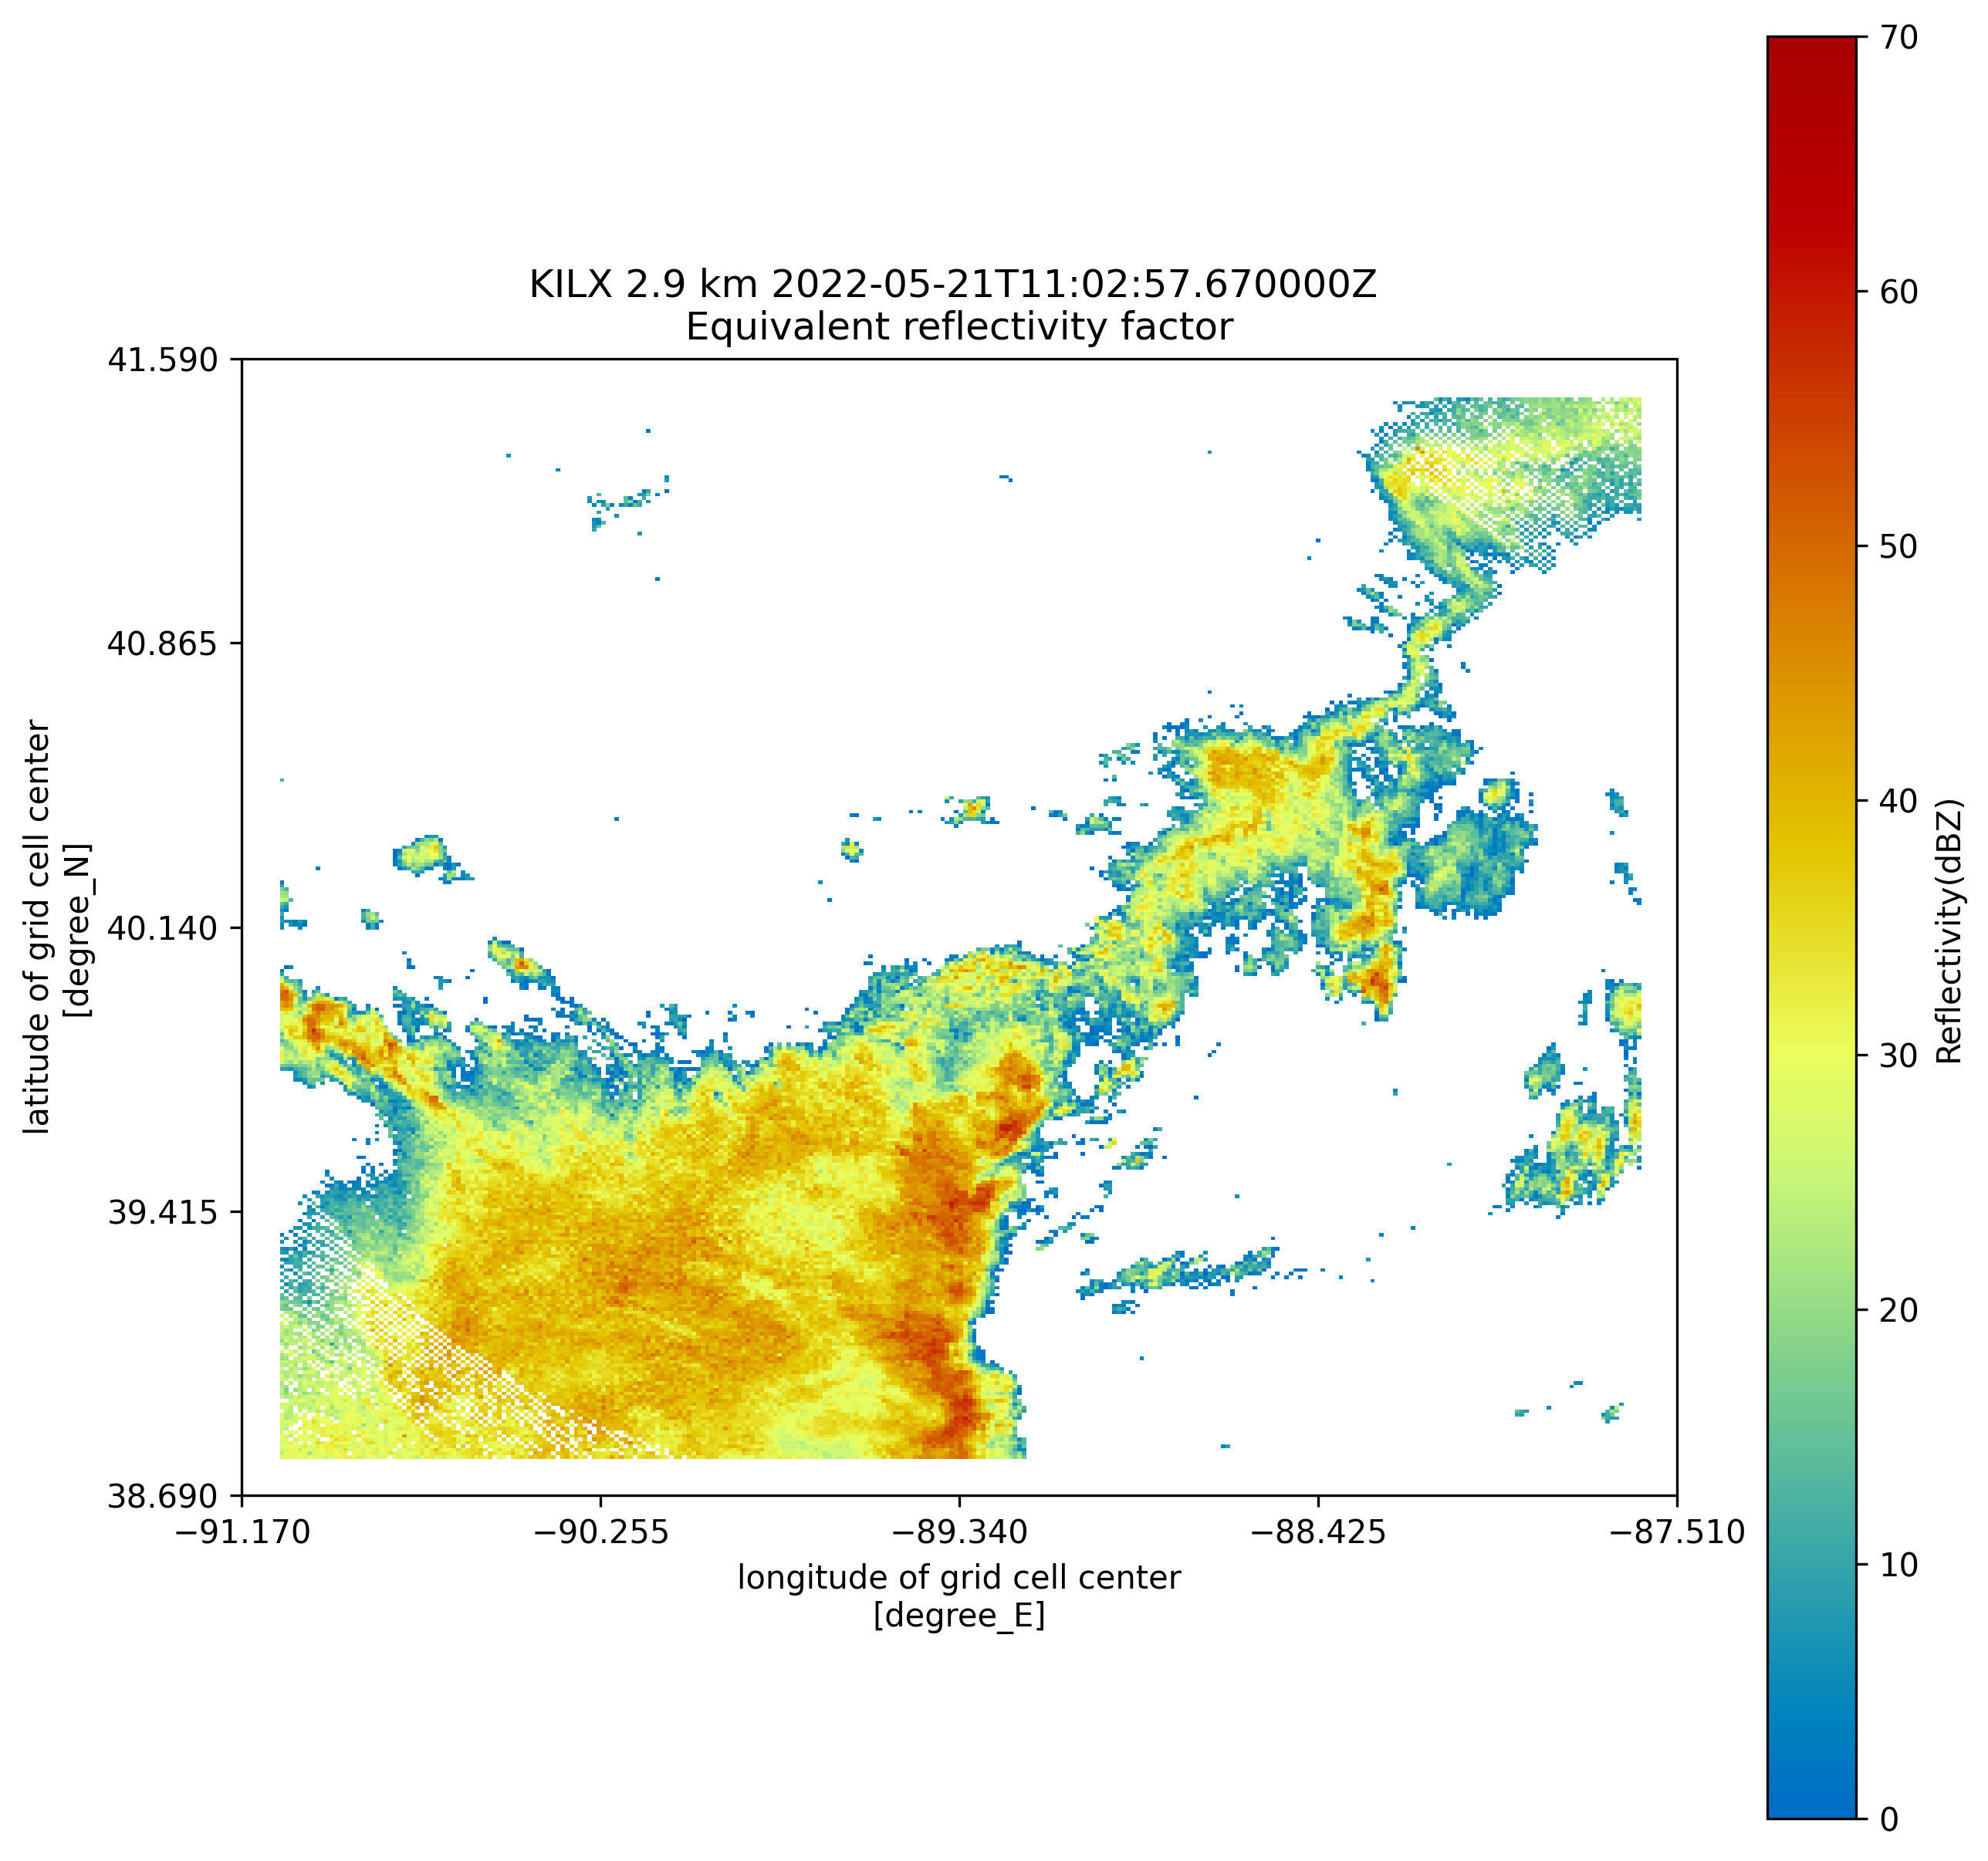
Objective analysis of storm morphology in radar data
erhtjhtyhy
Maggie Zoerner
Robert Jackson
Bhupendra Raut
SULI Intern
Iowa State University
Assistant Atmospheric Scientist
Mentor
Postdoctoral Fellow
Mentor
Environmental Science Division
Summer 2022

Slide 2
Background and motivation

Slide 3
Background
Why study storm shape (morphology)?
Provides key information about:
Dynamics that influence a storm’s development, evolution, and behavior.
A storm’s influence on its surrounding environment.

Slide 4
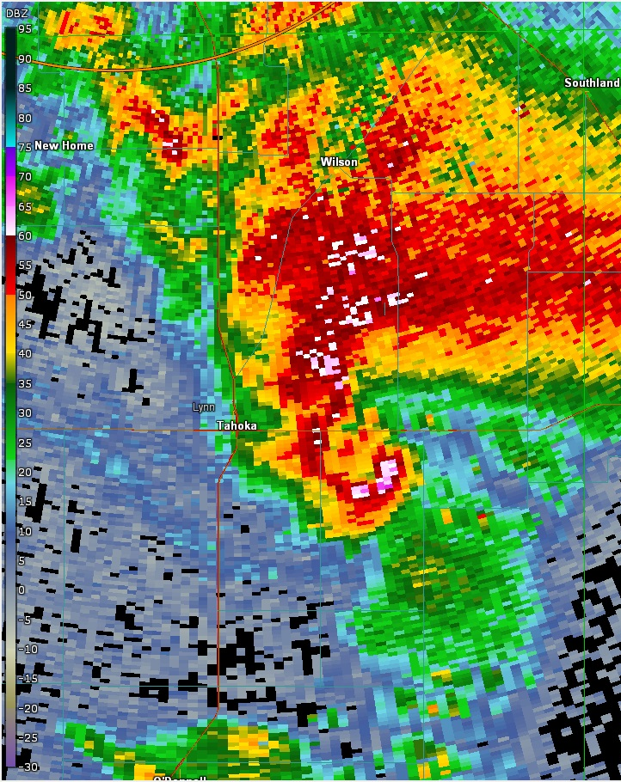
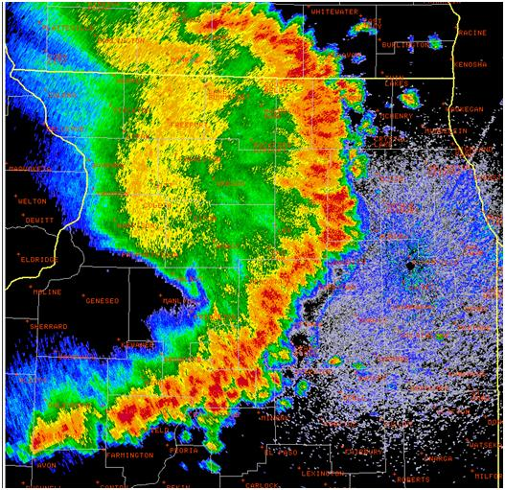
Background
Why study storm shape?
Images: National Weather Service

Slide 5
Background
Current numerical prediction models have deficiencies representing storm morphology.
Leads to:
Uncertainty in forecasts
A need for an improvement in the models

Slide 6
Background
Current morphological analyses include:
Manual classification based on appearance
Classification based on a single parameter (ratio of major/minor axes)
These techniques do not adequately represent a storm’s shape characteristics.

Slide 7
Motivation
Is the automated analysis of storm morphology a feasible technique?
We want to apply machine learning to improve the accuracy at which storm morphology is predicted.
Morphological parameters quantify the shape characteristics of binary objects in images making it possible to objectively classify and analyze the shapes.

Slide 8
methods

Slide 9
Image processing
Reflectivity scans from NWS Next Generation Weather Radar (NEXRAD) via Amazon Web Services
Using the Python ARM Radar Toolkit (Py-ART) to map the data on a cartesian grid

Slide 10
Image processing
Image pre-processing to remove noise.
OpenCV to perform contour analysis and shape parameter calculations including:
Moments
Skewness
Compactness
Elongation
etc.

Slide 11
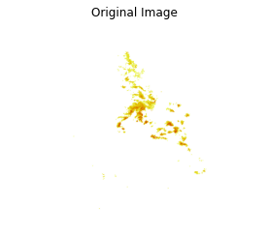
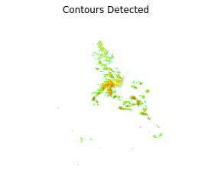
Contours

Slide 12
moments
Provide information about an image’s intensity at a certain pixel location
Unique to each image
Moment invariants are invariant to scale, translation, and rotation, meaning that this idea can be applied to more than just radar images (i.e., satellite imagery)

Slide 13
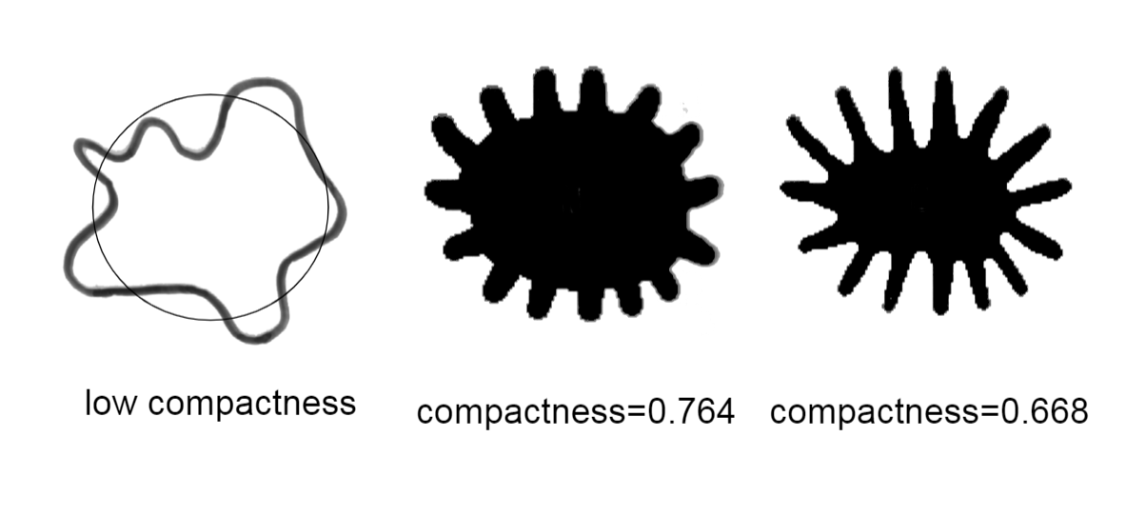
Image processing
Compactness
Dr. Michael A. Wirth, University of Guelph

Slide 14
Roundness

Slide 15
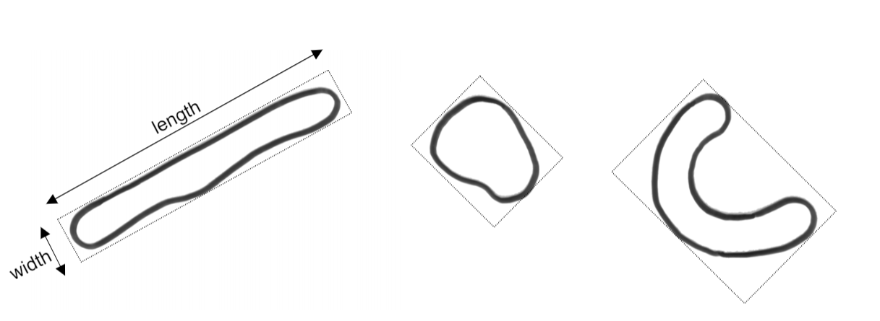
Image processing
Elongation
Dr. Michael A. Wirth, University of Guelph

Slide 16
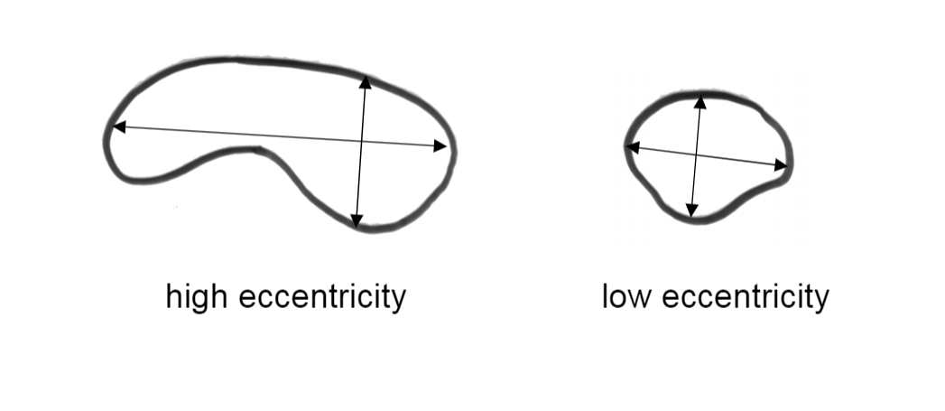
Image processing
Eccentricity
Dr. Michael A. Wirth, University of Guelph

Slide 17
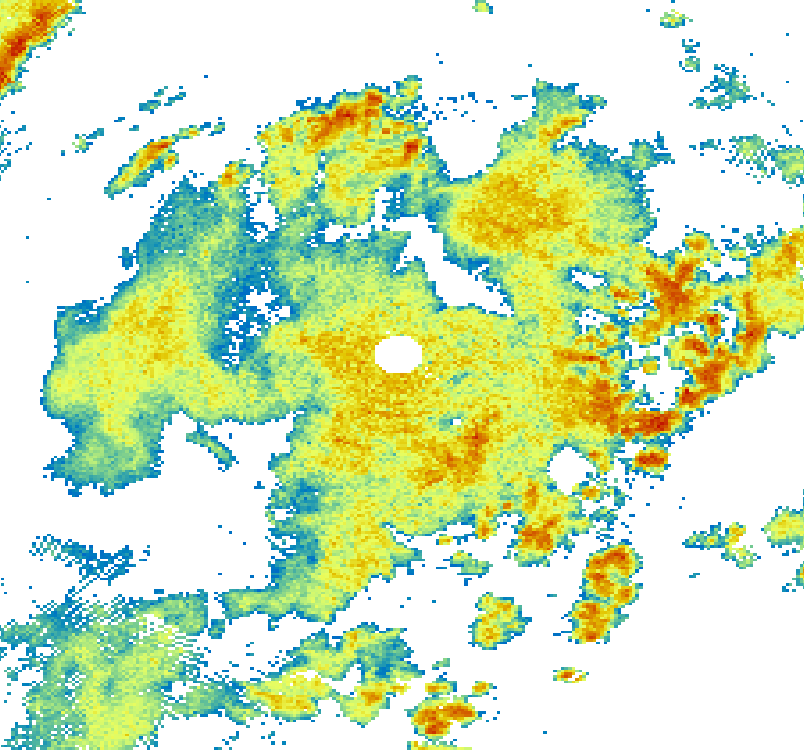
Image processing
Skewness

Slide 18
Statistical Analysis
Correlation Matrix
Determines the degree of correlation between the various shape parameters that were found.
Identifies which parameters provide the most information about shape.

Slide 19
Machine learning
Clustering
Cluster the radar images together based on similar shape characteristics.
Determines whether it is possible to identify and categorize storms by shape automatically.

Slide 20
Results

Slide 21
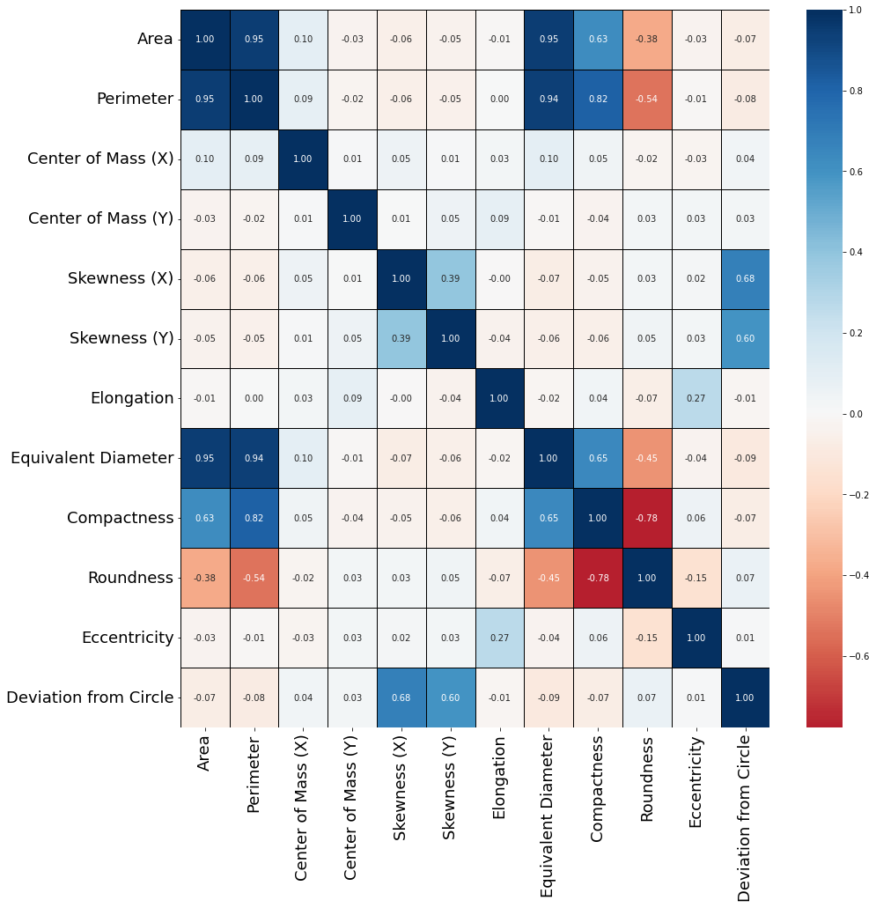
Results

Slide 22
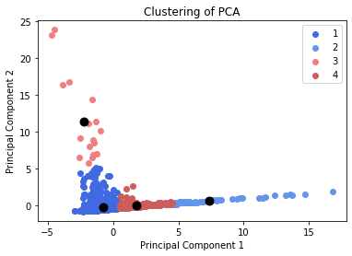
Results – Clustering
Principal Component Analysis (PCA)
- Helps to reduce the dimensionality of the dataset.

Slide 23
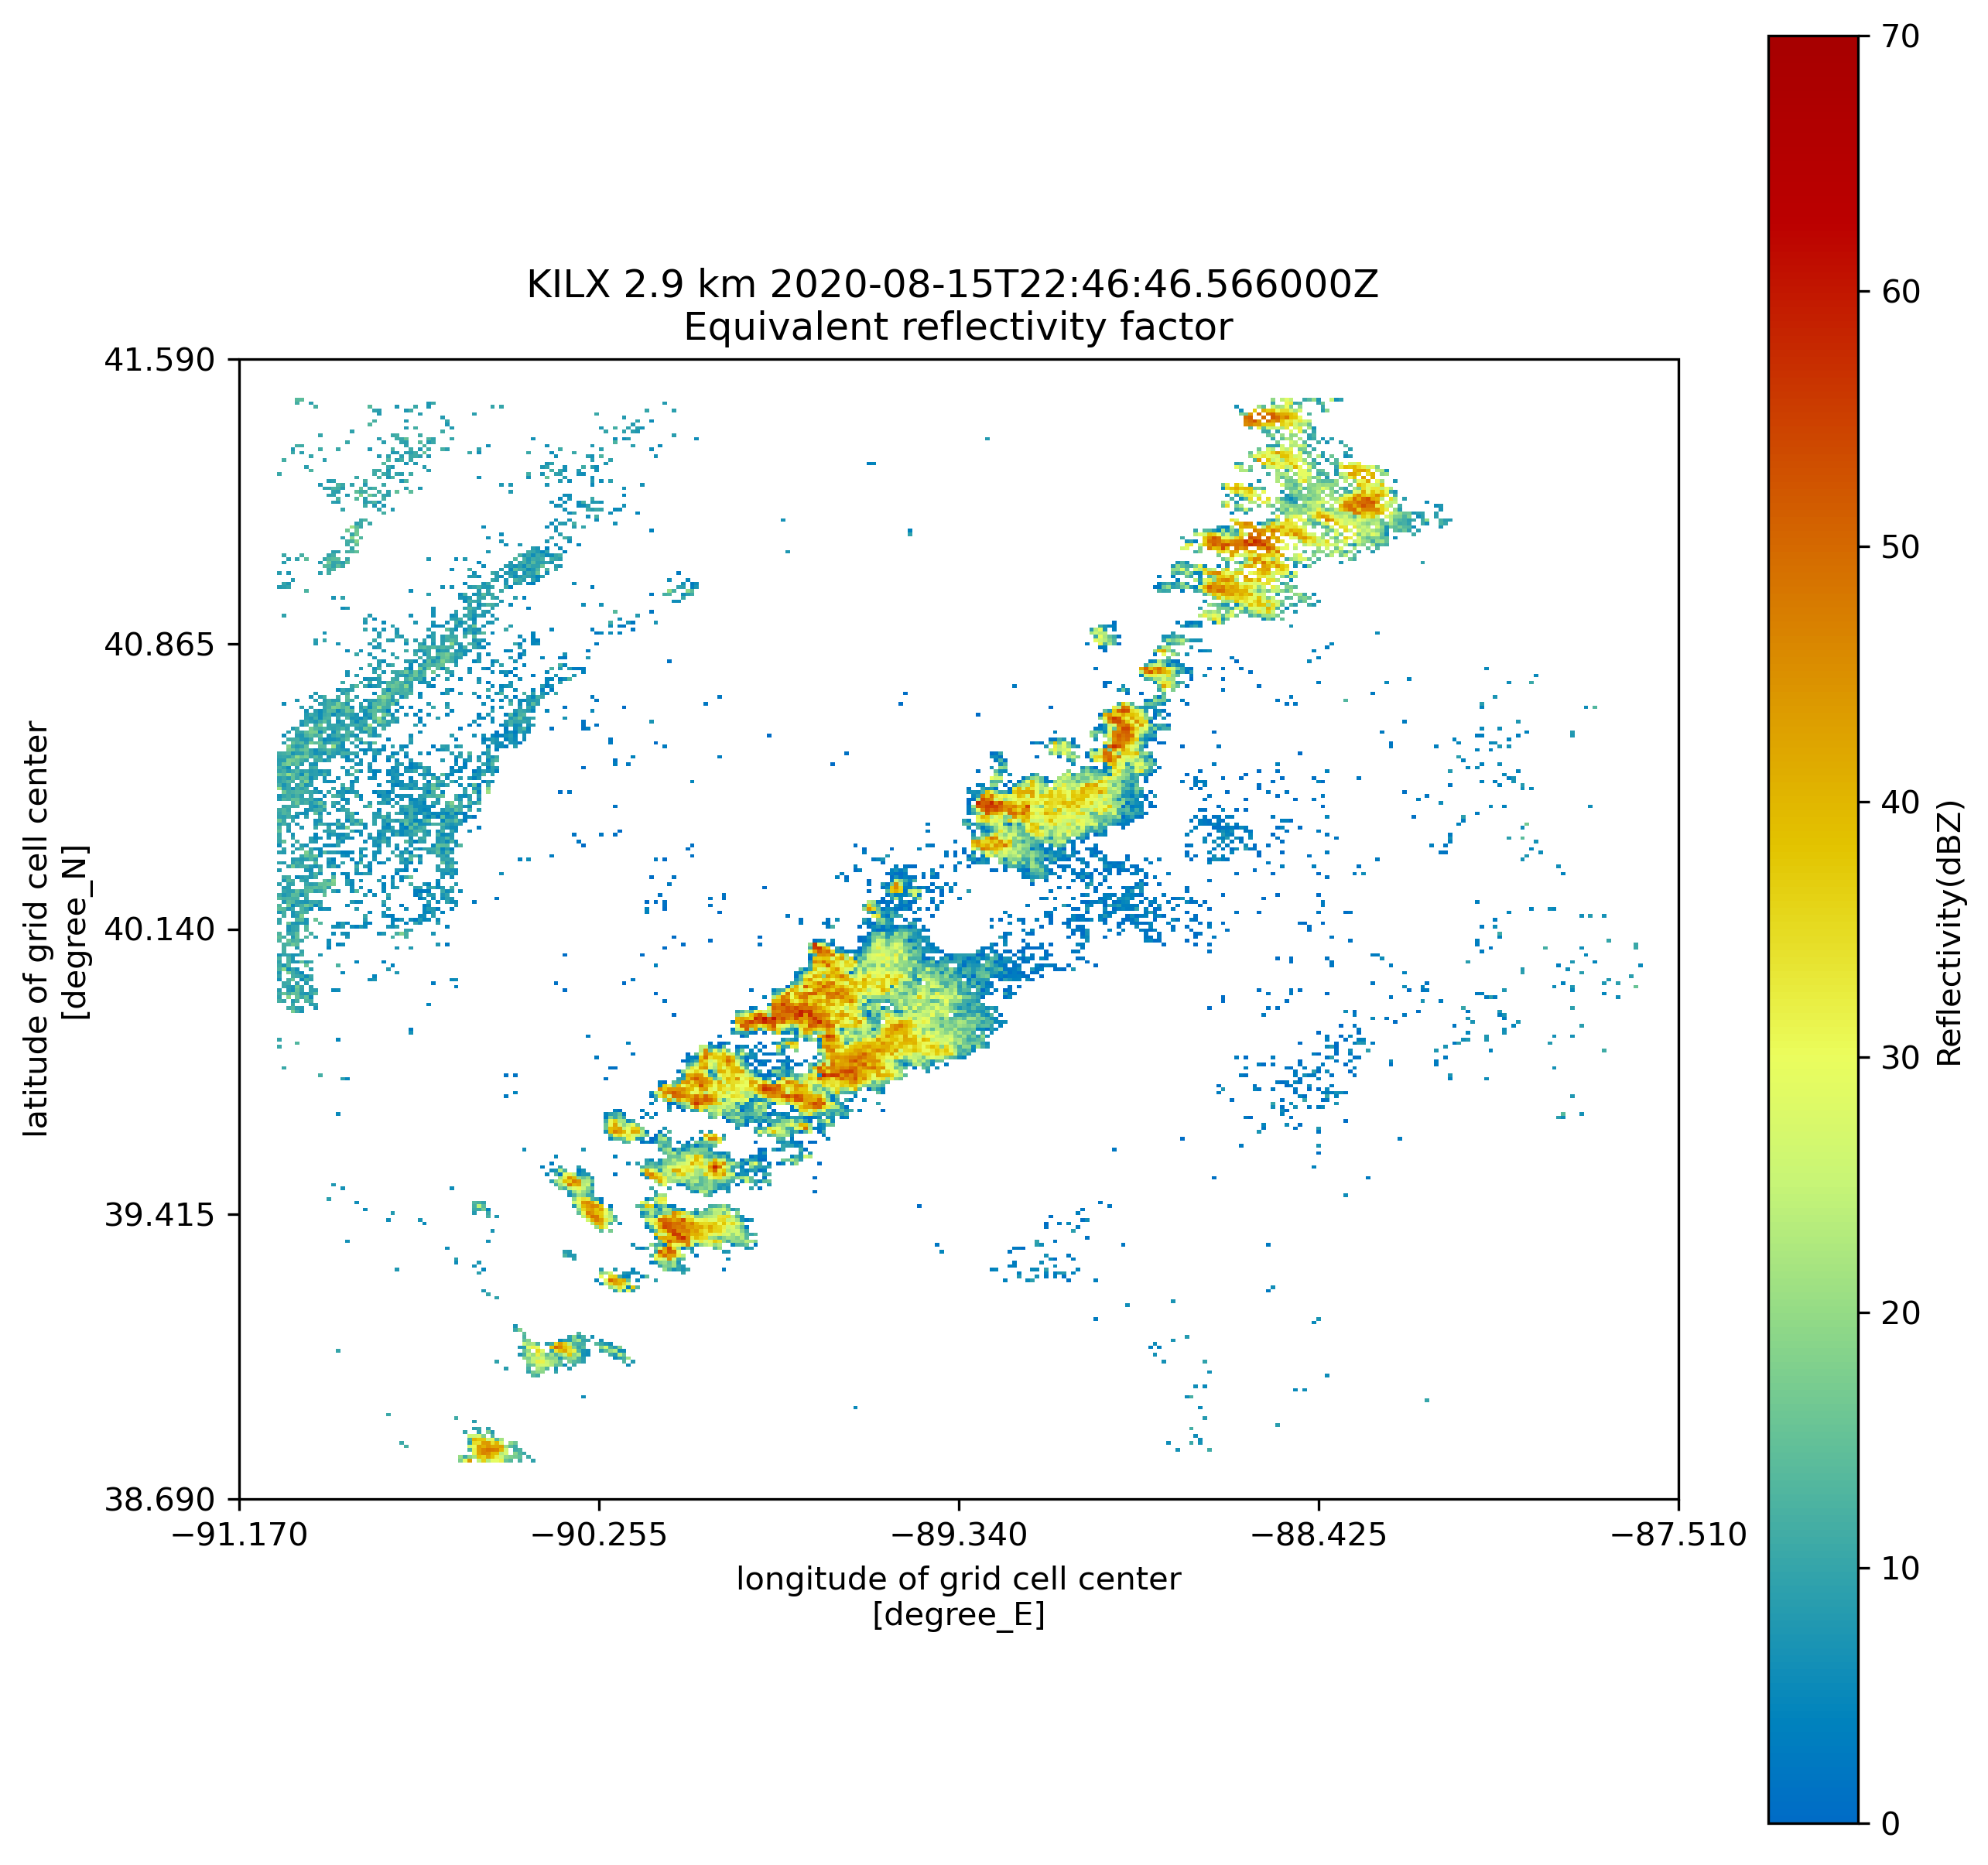
Results
Cluster 1

Slide 24
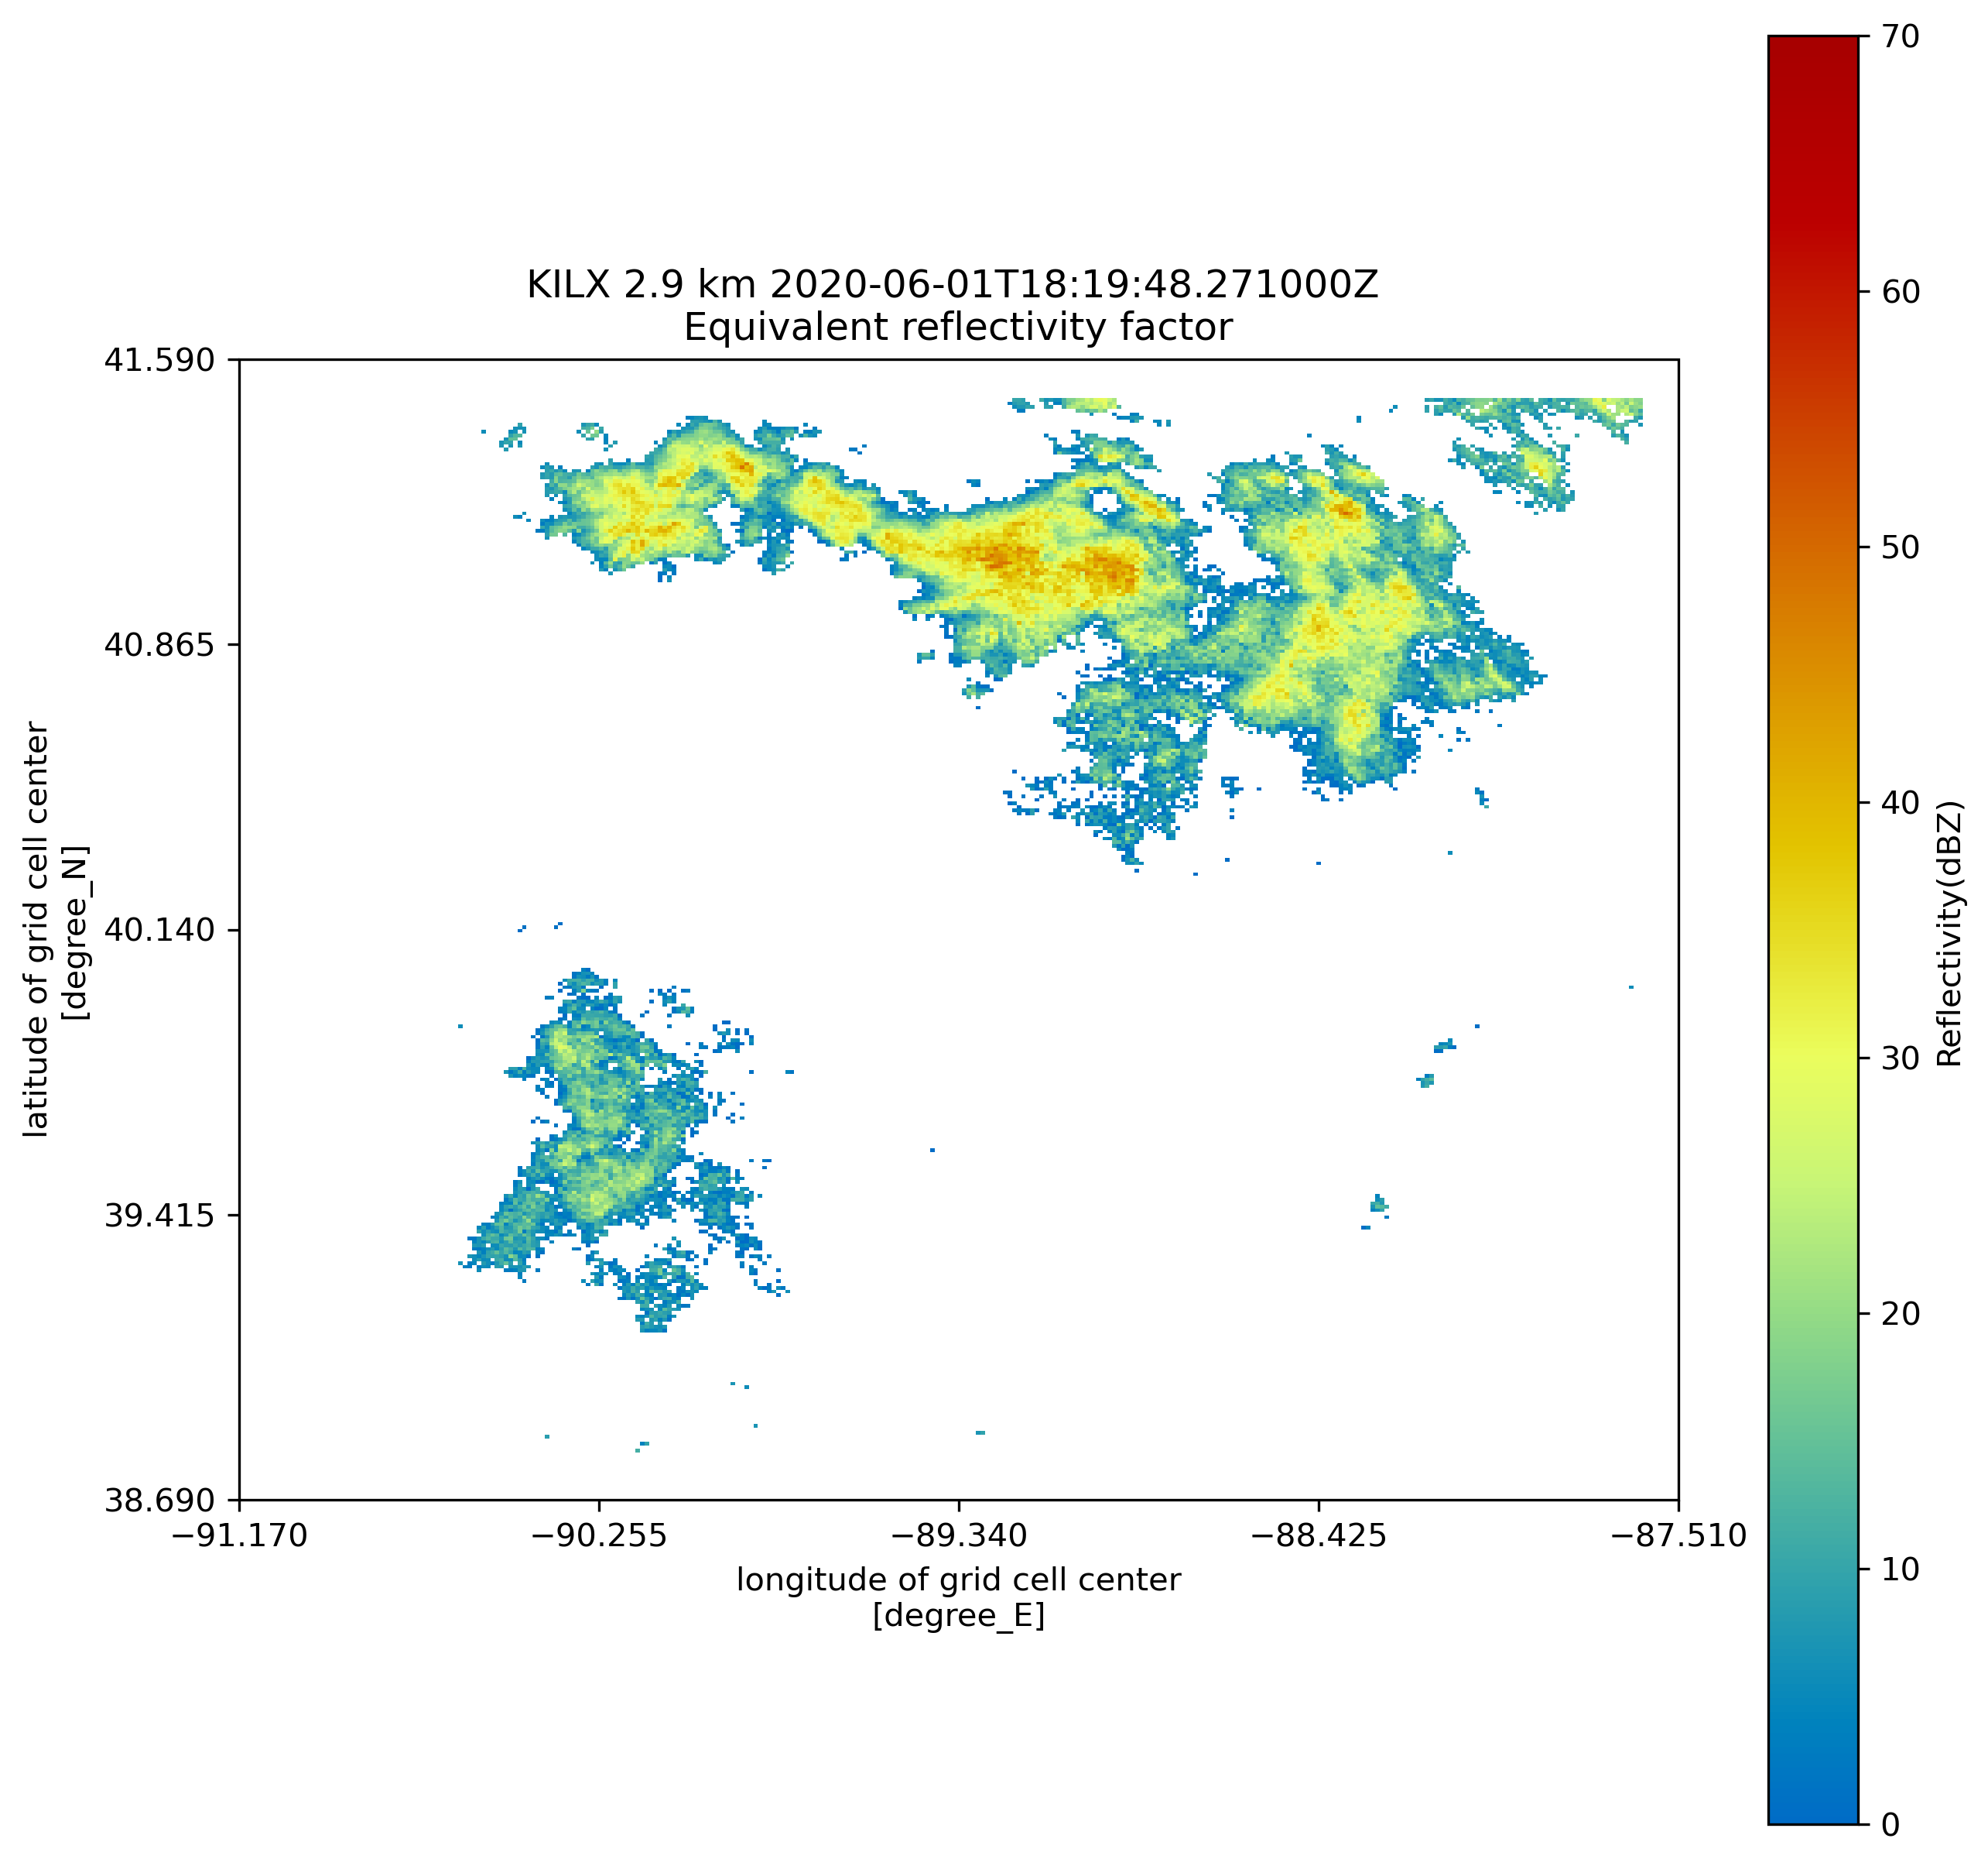
results
Cluster 2

Slide 25
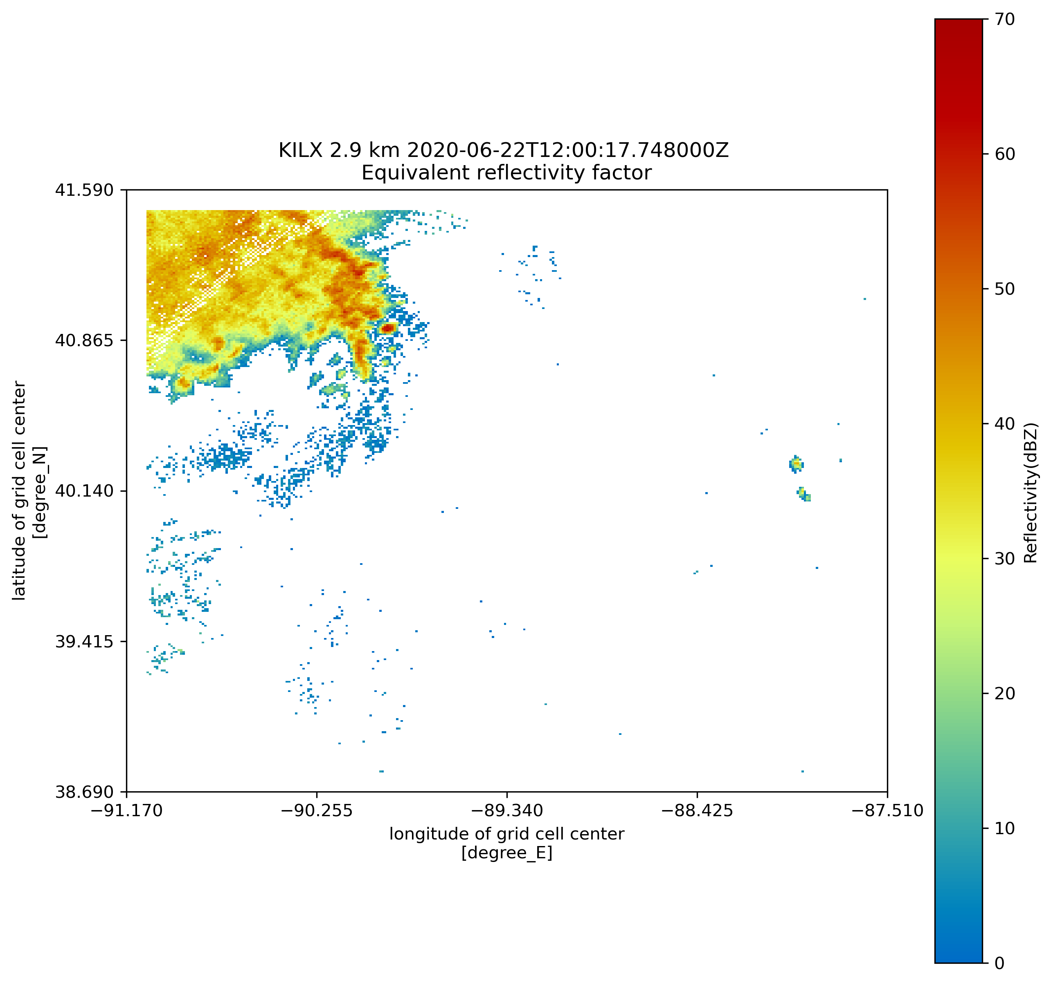
results
Cluster 3

Slide 26
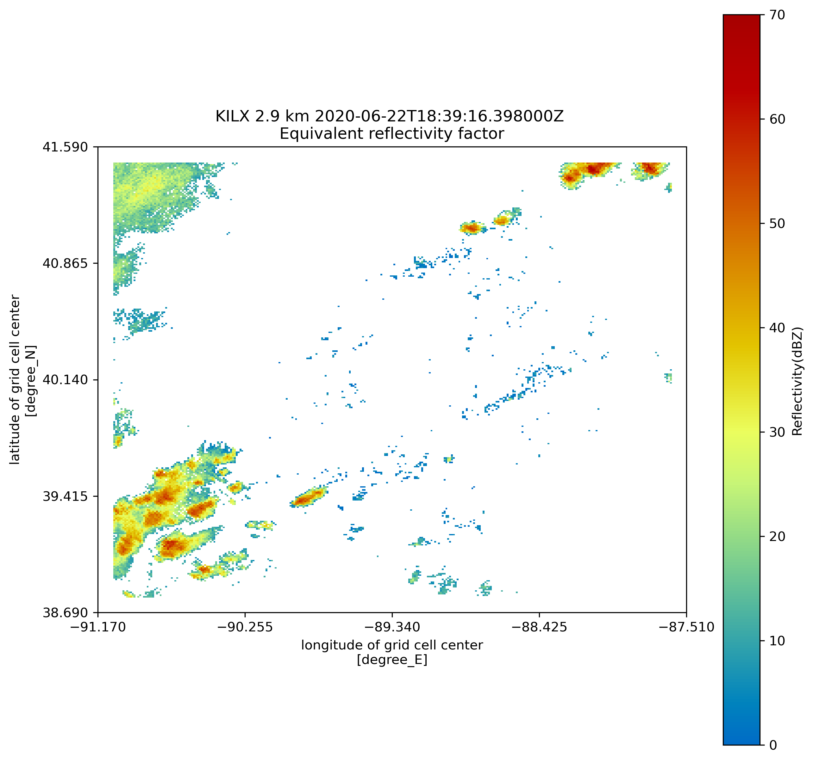
Results
Cluster 4

Slide 27
Discussion & Future Applications

Slide 28
discussion
Results indicate that this technique is feasible!
Each of the clusters contain radar echoes with their own distinct shapes.

Slide 29
discussion
However, this technique needs refinement.
Noise, broken convection, and other cases that need additional consideration skew the results.

Slide 30

Future applications
Provide a database of classifications of convective systems to the U.S. Department of Energy Atmospheric Radiation Measurement (ARM) user facility.

Slide 31
Future applications
Develop a Python package that can perform automated morphological analysis of convective systems.

Slide 32
Final Thoughts

Slide 33
Final thoughts
Is the automated analysis of storm morphology a feasible technique?
Though this process needs refinement, yes!
Impact
This method can help to improve the accuracy of weather and climate models.

Slide 34



Thank you
Contact:
This work was supported in part by the U.S. Department of Energy, Office of Science, Office of Workforce Development for Teachers and Scientists (WDTS) under the Science Undergraduate Laboratory Internships (SULI) program. Special thanks to my mentors, Robert Jackson and Bhupendra Raut for all their support.
maggiezoerner@gmail.com
linkedin.com/in/maggiezoerner
github.com/m-zoerner

